Slide 1
Dominion Pursuit
Iteration 1
Team members
Christopher Willingham
Bhuwan KC
Anil Karki

Slide 2
Team Vision
Our concept is to create a board game where players take turns to roll the dice for movement and choose one of three characters to move around the board in a predefined path, with the goal to have all 3 characters on the final space

Slide 3
Planned Features
The game will be 2D with local multiplayer and vs. AI modes.
Objective - Get all three of your characters to the end tile to win the game.
Components include the board, 3 characters per player, and 2 dice .
Gameplay - Roll 2 dice to determine movement and choose a character to move. When you land on a tile, an event will occur.
Event cards - Event Cards will gathered by characters when they land on specific spaces across the board. Their powers range from increasing or decreasing your movement, inflicting or healing damage, and freezing characters in place.
Characters - There will be a wide variety of characters to choose from to form your team, with each character having unique stats.

Slide 4
Competitors
Chutes and Ladders (Snakes and Ladders) The Game of Life Trouble
Our unique combination of mechanics:
Event cards that you gain and can play at any time to effect the board state.
Controlling multiple characters with the goal to reach the end with all 3.
Health system that determines when a character is defeated and sent back to a checkpoint.

Slide 5
Risks
1.Implementing functional and effective AI
Risk exposure RE: = pR * ER = 0.8 * 10 = 8 hours
Mitigation: implement simple AI and slowly develop its decision-making through many iterations and playtests.
2.Effective Graphic Design
Risk exposure= pR*ER= 0.75*8=6 hours
Mitigation: Spend time learning about graphic design to create simple, but effective graphics for the game.

Slide 6
Risks
3.Time management
Risk exposure RE: = pR * ER = 0.4 * 20 = 8 hours
Mitigation: Follow the agile method and use scrum to schedule our tasks and track our progress. We will meet at least twice a week to plan, distribute, review, and complete our assigned tasks.
4.Learning Unity and Inkscape
Risk exposure=Risk exposure RE: pR * ER = .6 * 15 = 9 hours
Mitigation: We will budget time for these problems to occur and watch various tutorials to learn how to utilize the programs effectively.

Slide 7
Risks
5.Game Balance
Risk exposure RE: pR * ER = .5 * 10 = 5 hours
Mitigation:To solve this problem, we will be performing many playtests throughout the semester and collecting data on win rates and pick rates. With this data we can determine both player perception of strength, and what is actually too strong or too weak.

Slide 8
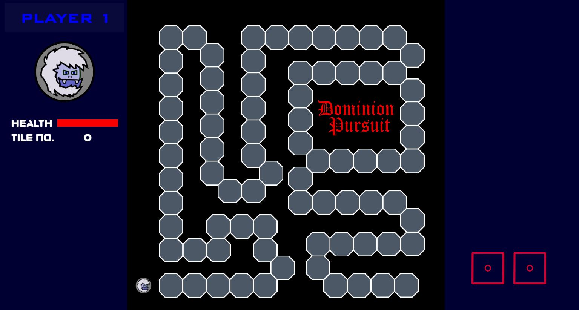
Current Design

Slide 9
Current Design
Dice-roll mechanism
Dice object - It is a Unity game object which handles the graphics, animation, and state behavior for the dice roll
Dice script - A C# script with an implementation of Dice class. The class incorporates the methods and properties required for the dice roll mechanism. The script is attached to the dice object.
Dice states
DiceStart - Initial state of the dice showing face 1
DiceRoll - State with dice roll animation
Dice# - 6 states with dice face # where # is a number between 1 and 6

Slide 10
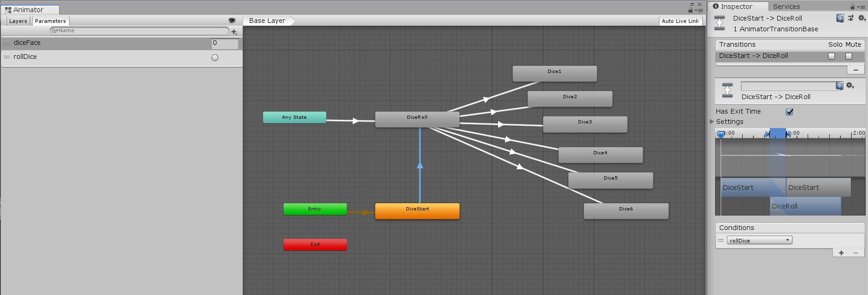
Current Design
Dice-roll mechanism
Fig - Dice roll state transition diagram from Unity

Slide 11
Current Design
Character movement
Character Object - It is a Unity game object which handles the graphics, animation, and state behavior for the player character
Character Script - A C# script with an implementation of Character class. The class incorporates the methods and properties required for the character game object. The script is attached to the Character object.
Character position status
On the left panel of the game screen, the player character’s status is displayed. As of now, it only shows the the character’s position on the game board.

Slide 12
Current Design
A short preview of the game...

Slide 13
Current Design
Game Input and Output
Input | Output
Player clicks on the dice | A roll-dice signal is sent to the dice object which changes its state from DiceStart to DiceRoll. After one iteration of DiceRoll state animation, a random number is generated between 1 and 6. The number is then sent as a signal to the dice object again. Depending upon the number received, the dice changes its face. The random number is also sent to the player object where it is used to move the player character across the tiles.

Slide 14
References
Codes and scripts files
GitHub - https://github.com/ablaze007/BoardGame
Sources
[1] https://www.thesprucecrafts.com/chutes-and-ladders-snakes-and-ladders-411609
[2]https://web.archive.org/web/20120907013112/http://www.harrogate-scene.com/vintagegames/pdfs/game%20of%20life1.pdf
[3] https://howdoyouplayit.com/trouble-game-rules-play-trouble/

Slide 15
Thank You
Any Question?

